Slide 1

Bladder Cancer 101
Insert your name here
Notes:
My name is [insert your name] . We are volunteers with the Bladder Cancer Advocacy Network and this is Bladder Cancer 101. We are here to tell you a little about us, about bladder cancer and introduce you to the organization that is on the front lines fighting this disease, the Bladder Cancer Advocacy Network.

Slide 2


How did I know?
What did I do?
How am I now?
Profile picture
Profile picture
Notes:
Tell your bladder cancer story.

Slide 3


Bladder Cancer in Numbers
79,030 diagnosed in 2017
600K + living with bladder cancer
most common cancer
5th
16,870 will die in 2017
“Statistics are human beings with the tears wiped away.”
4th
11th
50% - 80% recurrence rate
most common in men
most common in women
3
Notes:
Here are some basic facts about bladder cancer:
Bladder cancer truly is the most common cancer you’ve probably never heard of…
It is the 5th most commonly diagnosed cancer in the United States. It’s the 4th most commonly diagnosed cancer among men, and 11th among women.
In 2017, over 79,000 people are estimated to be newly diagnosed with bladder cancer and almost 17,000 people will die. There are over 600,000 bladder cancer survivors in the United States

Slide 4
What are the Signs & Symptoms?
Signs
Symptoms
Blood in the urine
Painful urination
Urgent need to urinate
Feeling the need (but unable) to urinate
Abdominal pain
Fatigue
Lower back pain
Appetite or weight loss
4
Notes:
Knowing the signs and symptoms of bladder cancer could save your life or the life of someone you love.
As I mentioned, the most common sign is visible blood in your urine. This is medically termed “gross hematuria”. There are, however, characteristics of this sign that may keep people from seeing their doctor. For example, the bleeding might be occasional and short-lived or that there is likely to be no pain associated with the bleeding.
Keep in mind that blood in the urine does not necessarily mean bladder cancer. Infections, kidney stones as well as aspirin and other blood-thinning medications may also cause bleeding.
However, it is important to see your doctor if you experience this.
Irritation when urinating, urgency, frequency and a constant need to urinate may be symptoms a bladder cancer patient initially experiences. Often, though, these are symptoms of a urinary tract infection and antibiotics become the first line of treatment. But because the signs and symptoms of bladder cancer are common to other issues, it is important to be conscious of any changes in urinary function and seek medical attention if or when those occur.
To make the necessary distinction between an infection and something more serious, it is critical that a urinalysis and/or a culture are done to detect any bacteria in the urine. If the culture is negative for bacteria, patients should be referred to a urologist for further testing.

Slide 5
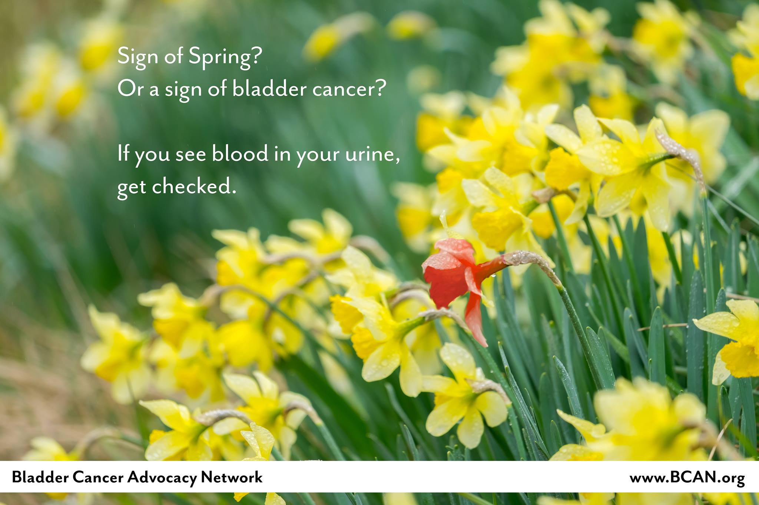
Notes:
Blood in your urine is one of the early signs of bladder cancer. But it could be something else. Some may have microscopic blood that they cannot see. Others don’t even have blood in their urine, I’ll tell you more about the signs in a minute. I just wanted to mention that BCAN had monthly social media messages designed to remind people, if you see blood, get it checked. A urologist is the doctor you would consult for hematuria. He or she would determine if it is cancer, or not!

Slide 6








What are the risk factors?
  3x more common in smokers
  Chemical/occupational exposure
  Arsenic in water
  Race, age, gender, birth defects
  Chronic bladder inflammation
  Medical history recurrence
  Low fluid intake
  Previous cancer treatment
Notes:
Its important to know the risk factors and if you are at risk, discuss this with your doctor.
Smoking is one of the greatest risk factors. Smokers are diagnosed with bladder cancer twice as often as people who don’t smoke. However, many people who have never smoked are diagnosed.
Some of the chemicals used in making dye have been linked to bladder cancer. People who work with chemicals called aromatic amines that are used in making rubber, leather, printing materials, textiles and paint products are also at greater risk.
Arsenic in drinking water and other environmental toxins have been linked to a higher risk of bladder cancer.
Race, Age and Gender can all be risk factors. Caucasians are twice as likely to develop bladder cancer as are African Americans or Hispanics. Asians have the lowest rate of bladder cancer.
The risk of bladder cancer increases as you get older. And while men get bladder cancer more often than women, recent statistics show an increase in the number of women being diagnosed with the disease.
Unfortunately, because the symptoms of bladder cancer are similar to those of other gynecologic and urinary diseases, women may be diagnosed when their disease is at a more advanced stage.
Remember the recurrence rate of bladder cancer is 50 to 75% so people who have had bladder cancer have a higher chance of getting another tumor in their urinary system. People with a family history of cancer may also have a higher risk. This isn’t necessarily a genetic link as it could be environmental. We won’t know what, if any, genetic link exists until more research is done.
And if you have had previous treatment for other cancers using particular drugs or radiation you may have an increased risk.
Risk factors can be personal, occupational and environmental as well as genetic.
It’s important to keep in mind that knowing the risk factors and avoiding those will not necessarily prevent a bladder cancer diagnosis, but you can certainly lower your risk by living a healthy lifestyle.
And if you are exposed to these risk factors and have signs and symptoms, please be sure you tell your doctor.

Slide 7
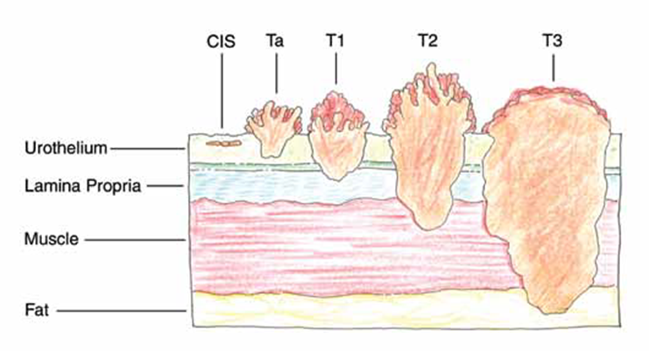
How is it Diagnosed?
Diagnostics
Cystoscopy
Tissue sample
Radiologic Tests
CT scan
Stage & Grade
7
Notes:
If your doctor suspects you may have bladder cancer it will be likely recommended that you see a urologist. (A urologist is a physician who specializes in diseases of the urinary tract and the male reproductive system.)
To diagnose bladder cancer, the urologist will typically do a cystoscopy, a test that allows your doctor to look at the inside of your bladder and urethra.
If anyone asks, here is an explanation of cystoscopy: It's done using a thin, lighted tube called a cystoscope that is inserted into your urethra and on into the bladder. Your doctor can see areas of your bladder and urethra that usually don't show up well on X-rays. Your doctor can also insert tiny surgical tools through the tube to take samples of tissue (biopsy) or samples of urine.
This is an invasive test that allows the doctor to look inside your bladder and can take a small tissue sample called a biopsy. Your urologist may also order radiologic tests like a CT scan to look at your bladder, ureters and kidneys to see if a tumor has spread beyond the bladder.
Next, a pathologist will look at the tissue sample taken during the cystoscopy to help determine if it is cancerous. There are usually several doctors involved in both the diagnosis and treatment of bladder cancer.

Slide 8
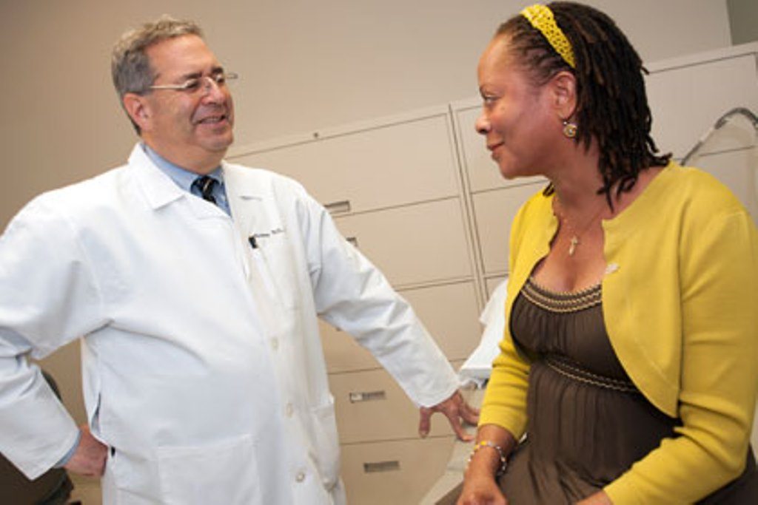
How is Bladder Cancer Treated?
Treatments
TURBT
Intravesical therapy
Bladder removal and urinary reconstruction
Chemotherapy
Bladder preservation
Immunotherapy
Immunotherapy is the first significant FDA approved advancement in bladder cancer treatment in over 30 years.
8
Notes:
The pathologist determines the stage and grade of the bladder cancer which helps determine the treatment options. One of the options is to surgically cut out the tumors from the bladder in a procedure called a TURBT (transurethral resection of a bladder tumor).
If the bladder cancer has not invaded the muscle layer, the urologist will usually use intravesical therapy, meaning that they put a drug directly into the bladder.
In about 30% of bladder cancer patients, the urologist will consider surgically removing the bladder. This is a life changing surgery called radical cystectomy where surgeons create a new urinary system which could be an external appliance (or bag) or an internal pouch or a “neobladder” made from part of the intestine. This treatment option has an enormous impact on quality of life for the patients and their families and caregivers.
Chemotherapy is commonly used before surgery, after surgery, and for metastatic treatment. When combined with radiation, chemotherapy can also be used as a bladder preservation therapy, but this is for very specific group of patients.
Looking at the list of treatment options, it is almost hard to believe that there have been no new Significant advancements in bladder cancer treatment for over 30 years. Only recently have new immunotherapies been approved for patients with advanced or metastatic bladder cancer.

Slide 9
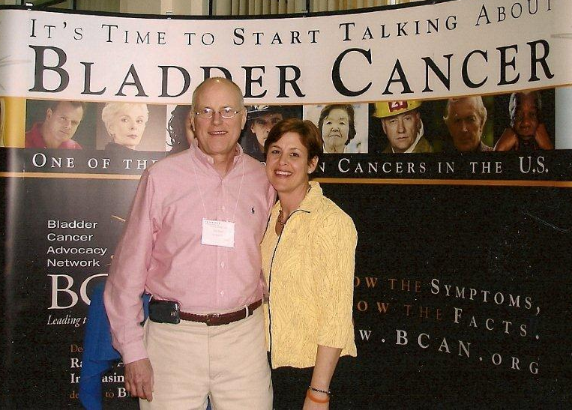
What is BCAN?
  Founded in 2005
  The leading voice for bladder cancer, BCAN is cultivating a community of hope and support for people impacted by the disease.
Notes:
BCAN was founded in 2005 by Diane Zipursky Quale and her late husband, John Quale, who had bladder cancer. Like me, they were concerned with the lack of education, awareness and research to find better ways to prevent, find and cure this wide spread and life changing disease. It is the first national non profit dedicated to bladder cancer and we are leading the way to awareness and a cure.

Slide 10




Mission,
Services &
Programs
  Advance research
  Bladder Cancer Think Tank
  Research grants
  Provide information
  and support
  Educational materials
  Support programs
  Raise awareness
  Speaker’s Bureau
  AmpUp! walk events
  Bladder Cancer Awareness Month
10
Notes:
The Bladder Cancer Advocacy Network’s mission is to increase public awareness about bladder cancer, advance bladder cancer research, and provide educational and support services for the bladder cancer community.
BCAN serves as the leading voice for bladder cancer in the U.S., providing resources to not only those diagnosed with the disease but their families, caregivers and the medical community united in support of people impacted by the disease.
The organization is setting the agenda for bladder cancer by promoting and funding collaborative and cutting-edge research programs and providing critical patient support and education services.

Slide 11
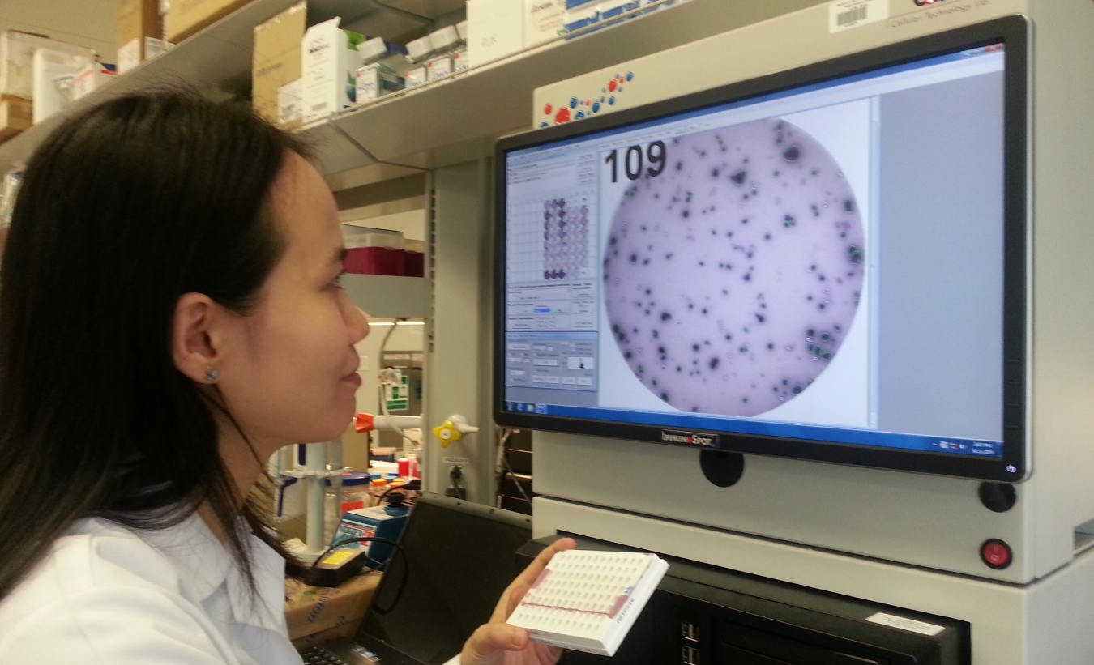




BCAN: Engaging the Medical Community
  Supporting Research
    Research awards
    Bladder Cancer Think Tank
    Clinical Trials
Scientific Advisory Board
64
    Nationally Recognized Multidisciplinary Experts
11
Notes:
BCAN supports BLADDER CANCER RESEARCH:
With grants to experienced researchers to explore innovative ideas to improve the lives of bladder cancer patients, smaller grants to start early career investigators interested in bladder cancer research. *
To date, we have invested over $1.5 million in bladder cancer research. Every year BCAN brings together bladder cancer experts in urology, medical oncology, radiation oncology, pathology as well as nurses, researchers, and patients advocates at the Bladder Cancer Think Tank the only bladder cancer specific scientific meeting in North America..
BCAN also hosts the Bladder Cancer Clinical Trials Dashboard, which is a resource that allows patients to find clinical trials using their diagnosis and geographic location.
BCAN is not only closely following the advancements made in research, but is also producing educational content about it.
Our Scientific Advisory Board has 64 members for prestigious medical institutions in the US and Canada.
Urologists, Radiation Oncologists, Medical Oncologists, Pathologists and Social Scientists (represented by the images).
*The researcher in the photo is Dr. Niannian Ji, PhD, one of BCAN’s 2016 Young Investigators.

Slide 12



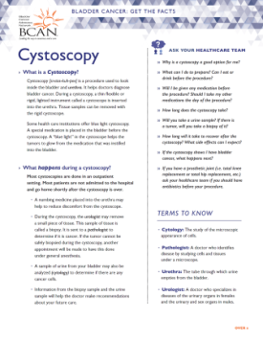
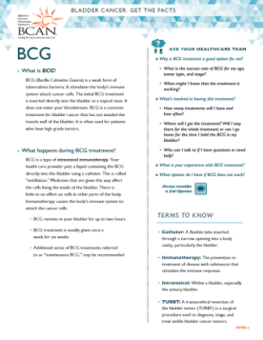
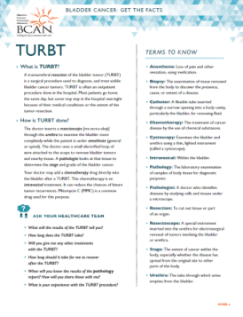
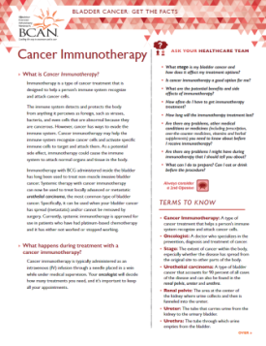


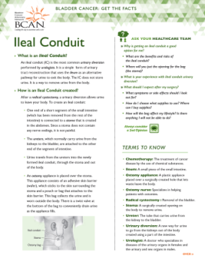
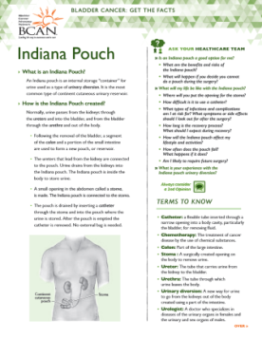
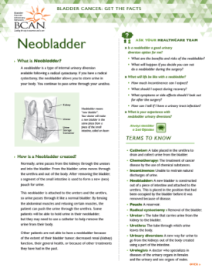
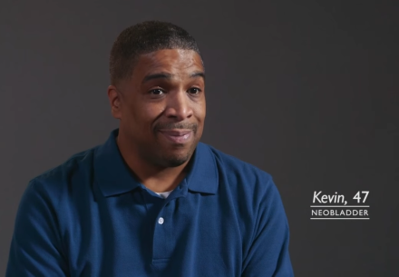
Bladder Cancer Patient Education
Patient Handbook
www.BCAN.org
“Conversations: Let’s Talk About Bladder Cancer”
“The New Normal:
Living with a Urinary Diversion”
Interviews
“Bladder Cancer: Get the Facts”
Tip Sheets
12
Notes:
Patient education resources include our comprehensive Bladder Cancer Basics as well as plain language Get the Facts pages with tips from patients-for patients.
Education about bladder cancer is our top priority, and here is a list of just some of our resources:
“Bladder Cancer Basics for the Newly Diagnosed” is one of the most comprehensive patient handbooks for bladder cancer. There are over 250,000 copies of this patient handbook in print and online downloads average 3 per day.
The Patient Insight Webinars were established in 2012, and is an archive of installments addressing patient concerns and Q&A with topics ranging from “the New Normal” to updates on research development.
The Video series, “Conversations: Let’s Talk About Bladder Cancer” has 5 installments with nearly 5,000 views since 2013 and our newest series, “The New Normal, Living With a Urinary Diversion,” features interviews with men and women who have had to had their bladders removed.
Patient Tip Sheets have been Created for survivors by survivors on various survivorship topics
These resources are available 24/7 online-so whenever a patient or family member wants to know more-BCAN is there!
All of these resources are easily accessed on our website at www.bcan.org. Including a special section on women and bladder cancer which is uniquely important because of the rise in cases among women and the high mortality rate.

Slide 13




Bladder Cancer Patient Support
Clinical Trials
Dashboard
Online Community
13
Notes:
I mentioned the Clinical Trials Dashboard which is a resource for doctors and patients looking for treatment and helping to advance research by being part of a critical piece of the treatment discovery process.
BCAN Connection is a referral line providing practical resources for bladder cancer patients and their loved ones with nearly 800 phone requests annually.
“Survivor 2 Survivor” is a volunteer phone support program matching the newly diagnosed with survivors with a similar diagnosis.
The Online Community hosted by Inspire with almost 23,000 members representing patients and caregivers from 50 US states and 106 countries.

Slide 14


How Can I Help?
Know YOUR risk
Get involved!
Talk About the Signs & Symptoms
Volunteer
Be Proactive
Donate
Get Support
AmpUp! – Spring
Hold a FUNdraiser
14
Notes:
How can you help?
Get involved by volunteering. The Triangle area has a very active local BCAN Chapter. They put on the annual Bladder Cancer Walk on the first Saturday in May. In addition, they are currently piloting a project to provide ‘My Journey” journals specifically targeted to newly diagnosed patients and securing a grant to help fund ostomy supplies to Triangle residents who cannot afford them.
There is also a very active support group for survivors, caregivers, and others touched by bladder cancer. This group meets monthly providing speakers discussing bladder cancer related issues and plenty of time for individual sharing.
Get involved by volunteering. We have a national volunteer program: you can provide support to newly diagnosed bladder patients through BCAN Connection and Survivor 2 Survivor Program (both virtual programs), and the Speaker’s Bureau is a volunteer opportunity that you can participate in in your local community.
If you don’t have time to volunteer, please donate or join us in our Walk for Bladder Cancer. If walking isn’t your thing, you can always create your own fundraising event with BCAN’s easy to use “event in a box”.
You can also help by knowing YOUR risk and talking about the signs & symptoms with your family, friends and loved ones. And if you or those you care about have symptoms, be proactive and take action. See your doctor, it could save your life or the life of someone important to you.

Slide 15

Thank you!
Visit www.BCAN.org to learn more
Questions?
15

